Slide 1
Week 3 – Topics
Arrays
Methods
JavaDocs
Objects (and Classes)
Equality in Primitives vs Objects
Menu App Example

Slide 2
Arrays

Slide 3
Arrays
An array in Java is a container which holds a fixed number of values of a single type. The length of an array is set at the time that it is declared or instantiated, and remains fixed for the life of an array. Additionally the type contained in an array can be a primitive datatype, or an Object type.
Some useful array information and vocabulary is contained here:
Square Brackets or [] tell Java that we are declaring an array
Each item stored in an array is called an element
elements within the same Java array must all be the same data type.
index: each element in an array is found or accessed by its numerical index.
arrays are zero-based, so the index values start at 0.
the first element in any array is located at index: 0
the last element of any array is located at index: arrayName.length – 1
Just like any variable in Java, an array must be declared. We declare the array to give it a name, and to allocate space for the size of the array that we declare. Note, that we also must determine the data type of the elements that will be stored in this array, so that Java knows how to store and manage the elements in the array.
https://github.com/ckiefriter1/Java-Code-Examples/tree/main/src/arrays
Content Link in LMS
https://github.com/ckiefriter1/Java-Code-Examples/blob/main/src/arrays/ArrayDemo.java
https://github.com/ckiefriter1/Java-Code-Examples/blob/main/src/arrays/MultiDimArrayDemo.java

Slide 4
Methods

Slide 5
Methods
Java uses methods to accomplish predefined tasks. A method is a block of code that runs when it is called. When you write a program and realize that you are writing the same code over and over, it's time to put that code into a method. A method is a set of coding instructions which can be referenced by name, and called at any point in a program by simply using the method's name.
What is a method declaration / method signature?
modifier(s) returnDatatype methodName (datatype1 par1, datatype2 par2) {
BodyOfMethod
}
Here, these parts of the method declaration are explained below:
modifier − modifier -- public, protected, default and private
returnDatatype − the return datatype (Can be a Java primitive datatype, an Object, or a Collection of a datatype or an Object, or can be void).
methodName − name of the method
datatype1, datatype2 - datatypes of the parameters
par1, par2 − formal parameter names
datatype1 par1, datatype2 par2 − list of parameters (Can be as many as you need, separated by commas)
BodyofMethod —> this is where you put your code… anything that you want to accomplish in that particular method. All Java code, and will include variable declarations, method calls, etc.
https://docs.oracle.com/javase/tutorial/java/javaOO/methods.html
https://github.com/ckiefriter1/Java-Code-Examples/tree/main/src/methods

Slide 6
JavaDoc

Slide 7
JavaDocs
Documenting your code is crucial to help others understand it, and even to remind yourself how your own older programs work. Unfortunately, it is easy for most external documentation to become out of date as a program changes.
For this reason, it is useful to write documentation as comments in the code itself, where they can be easily updated with other changes. Javadoc is a documentation tool which defines a standard format for such comments, and which can generate HTML files to view the documentation from a web browser. (As an example, see Oracle's Javadoc documentation for the Java libraries at http://download.oracle.com/javase/6/docs/api/.)
/** Indicates JavaDoc comment */
Use tags in comments to indicate JavaDoc parts
@param – defines parameters for input
@return – indicates what value and type are return from method call
@author (classes and interfaces only, required)
@version (classes and interfaces only, required. See footnote 1)
@param (methods and constructors only)
@return (methods only)
@exception (@throws is a synonym added in Javadoc 1.2)
@see
@since
@serial (or @serialField or @serialData)
@deprecated (see How and When To Deprecate APIs)
https://www.oracle.com/technical-resources/articles/java/javadoc-tool.html
https://docs.oracle.com/javase/6/docs/api/java/util/Scanner.html

Slide 8
Appendix

Slide 9
Objects

Slide 10
Primitives vs Objects
A primitive datatype is just a piece of data and nothing more.
int age = 19;
System.out.println("Age is: " + age);
An Object (e.g. String, Array, etc..) has a value, but there is much more. An Object has properties and methods which are defined on that object, and are accessed via dot-notation. For example, we can declare a String name, which is an object, and use the method name.length() to print out the length of the String stored in the variable name
String name = "Chip Brown";
System.out.println("The length of name is: " + name.length());
The main difference between a primitive datatype and an Object is that a primitive datatype does not have properties and methods defined on it.
When creating your own Objects, you can define them as you need. For example in our GradeBook example from the Array Section, we needed a Student Object, so we declared a Class named Student. Student has two fields: fullName and grades, a Constructor named Student(), and a method named describe().
Additionally, you will notice that Student is a Class. In Java, a Class is the template from which an Object can be created, and an Object is an instance of that class. We use the word "instantiate" when we describe the creation of an Object from a Class by use of the Constructor of that Class.

Slide 11
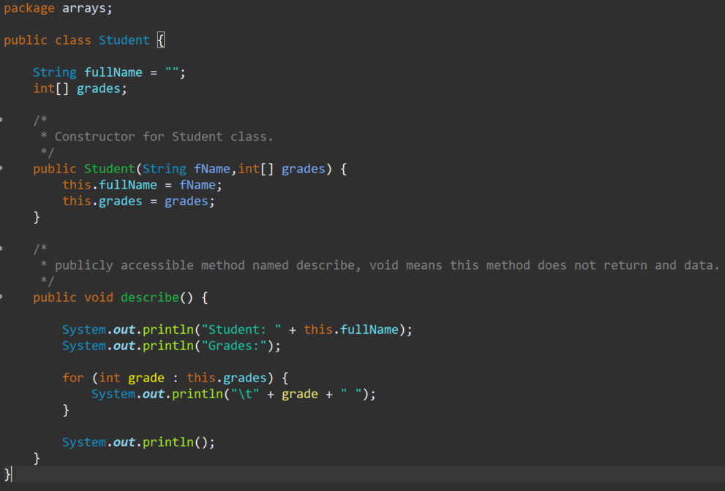
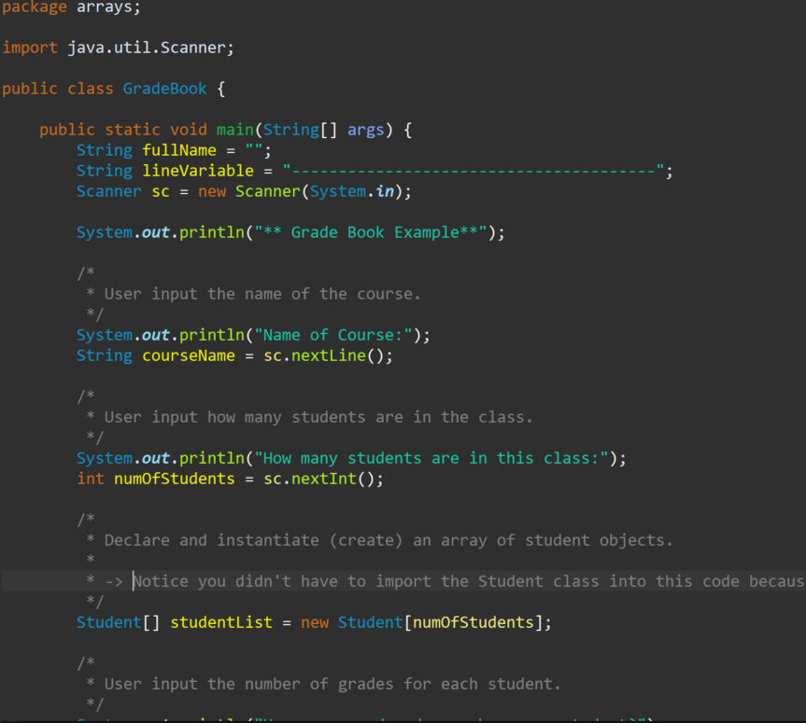
More Arrays – with Objects
Creating and using Arrays of Objects
Defining Classes and instantiating Objects from Classes
https://github.com/ckiefriter1/Java-Code-Examples/blob/main/src/arrays/Student.java
Content Link in LMS
https://github.com/ckiefriter1/Java-Code-Examples/blob/main/src/arrays/GradeBook.java

Slide 12
Equality in Primitives vs Objects

Slide 13
Equality in Primitives vs Objects
Another difference between primitive data types and Objects has to do with Equality. The Equality Operator in Java == checks to see if two references are the same. In other words when comparing Primitive Datatypes, == checks to see if two values are the same. With Primitive Datatype Equality Comparison, == checks the in-memory value of the Primitive Datatype against the in-memory value of a different Primitive Datatype.
Primitive Datatype Equality
The following code declares two int variables, and compares the value. Since these two variables are pointing to the same value, the System.out.println() will print the following result: age1 == age2: true
Object Equality
Remember that when an Object is instantiated, the programmer has access to all properties and methods that are defined within that Object, through dot-notation.
With the declaration of a new Object, Java creates that object as its own instance in memory. Even if two Objects are created with the same exact content, the Objects themselves will be created as two separate instances in memory. The point here is that each instance has its own location in memory, and the location is not the same, even if the values within the fields are the same.
Let's look at our Grade Book Example above. Imagine that we instantiate two students using the Student() Constructor as follows:
int[] grades = { 100, 100, 100 };
Student student1 = new Student("Molly Mack", grades);
Student student2 = new Student("Molly Mack", grades);
Notice that the data is exactly the same, but we are creating two distinct Objects by using the new keyword. So, if we run the following comparisons, the results will be reflect that the student1 Object is not the same as the student2 Object, because their locations in memory are distinct. These are Objects, not Primitive Datatypes. The only one of the following examples that will be true is when we compare the student1.fullName to "Molly Mack" with the .equals() method.

Slide 14
Menu-Driven Applications

Slide 15
Menu-Driven Applications
Menu-driven Applications are very useful in the coding world. They allow a program to receive data directly from a user. The user is provided a menu, and then is instructed to select an option from that menu. The chosen option will be used by the program to execute a code path (or branch) specific to that option.
In the Back End, the menus we create are text based. Adding a Client, or Front End program, which reads in user data, and then communicates to a Back End Server could provide a graphical user interface for the Menu.
Menu-driven applications are used in a variety of industries, including but not limited to computing, application development, banking (ATMs), websites, tablets, self-guided machines, word-processors, gaming, and more
Menu-Driven Application:
Advantages:
User-friendly
- Provide guidance to the user
- No need for a user to remember commands
Allow a user to control how and in what order a program executes
Disadvantages:
Difficulty finding content, especially with nested sub-menus
https://github.com/ckiefriter1/Java-Code-Examples/tree/main/src/menus

